Slide 1
Customer Churn Prediction
Garima Mahajan

Slide 2
Objective
The objective of this problem is to develop a predictive model that accurately forecasts customer churn based on various features such as age, income, spending behavior, and membership duration. The goal is to identify customers who are at high risk of churning and enable businesses to take proactive measures, such as targeted marketing or retention strategies, to reduce churn and improve customer retention..

Slide 3
Steps
Data Preprocessing:
Handled missing values.
Converted categorical features into numerical ones (e.g., Gender).
Standardized numerical features (e.g., Income, SpendingScore)
2. Feature Engineering:
Created interaction terms between key features (e.g., Age × Income).
Added polynomial features (e.g., Age²).
Added a short membership indicator (less than a year of membership).
Created churn risk categories based on membership duration.
3. Handling Class Imbalance:
Applied SMOTE (Synthetic Minority Over-sampling Technique) to address class imbalance,
ensuring the model had enough data to effectively predict churn.

Slide 4
Steps
3. Exploratory Data Analysis (EDA):
Visualized data and check feature distributions.
Analyzed correlations and check for class imbalance.
4. Model Selection:
Splited the data into training and testing sets.
Trained models like Logistic Regression, Random Forest, GradientBoosting, Neural Networks
Tuned hyperparameters for best performance.
5. Model Evaluation:
Evaluated using metrics like Accuracy, Precision, Recall, and AUC-ROC.
Compared models and choose the best one.

Slide 5
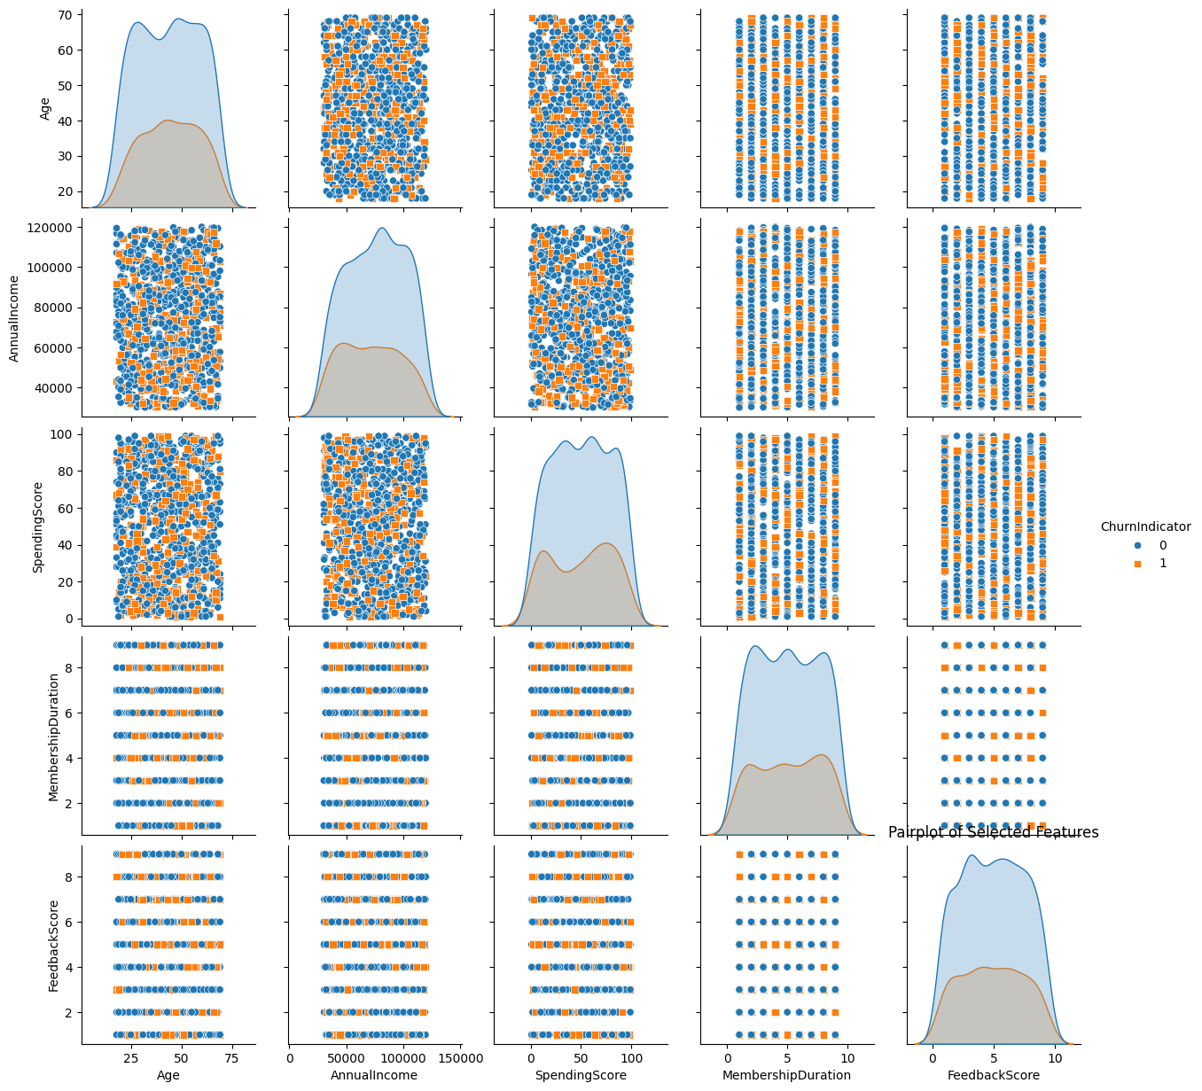
Exploratory Data Analysis
General Trends:
No Single Dominant Predictor: The churn seems to be influenced by a combination of factors rather than a single feature.
Membership Duration Impact: Shorter membership duration could be a risk factor for churn, indicating new customers are more likely to leave.

Slide 6
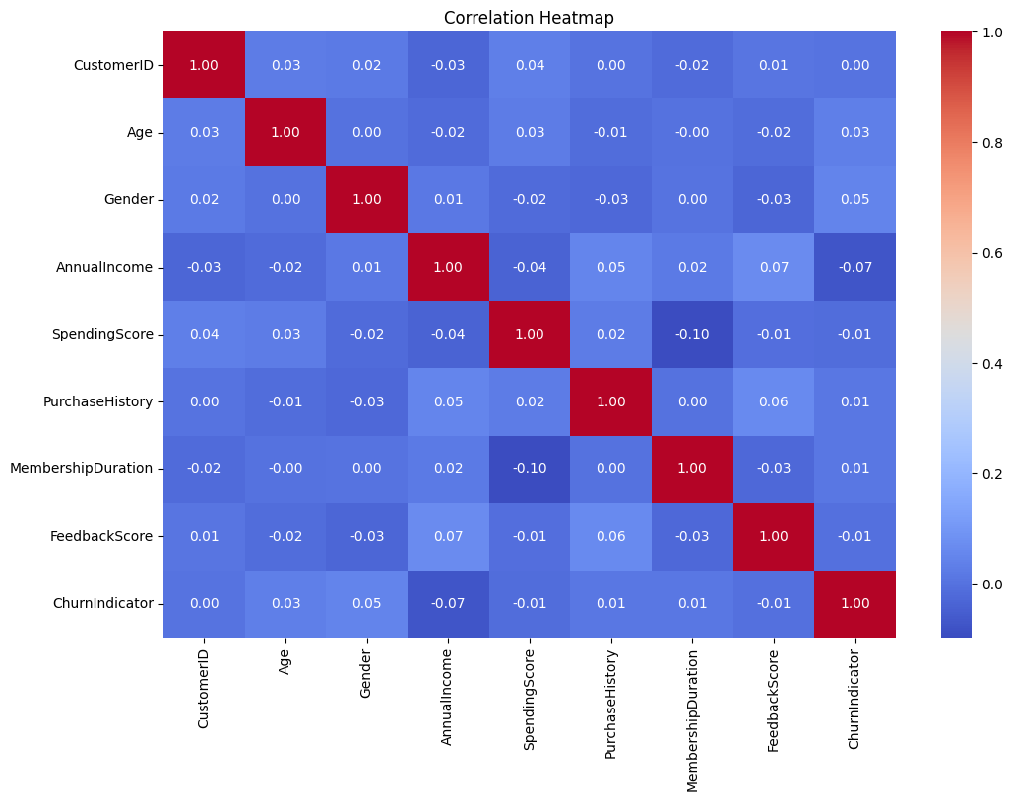
Correlation Matrix
Interpretation:
Age & PurchaseHistory: Older customers tend to have more purchases.
Annual Income & MembershipDuration: Higher-income customers stay longer.
FeedbackScore & ChurnIndicator: Higher feedback scores mean lower churn.
AnnualIncome & SpendingScore: Higher income leads to higher spending.
ChurnIndicator & MembershipDuration: Longer memberships result in less churn.
Age & ChurnIndicator: Older customers churn less.

Slide 7
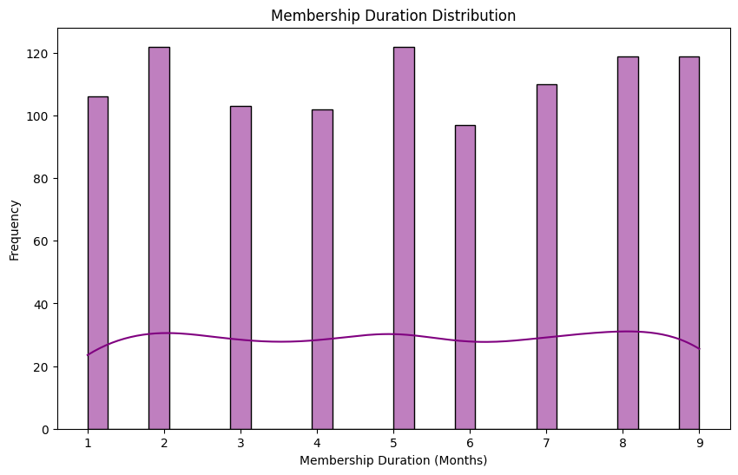
Membership Duration Distribution
Peaks: Highest frequency at 2, 5, and 8 months (around 120 members each).
Lowest: Low frequency at 6 months (slightly above 60 members).
Insights:
Engagement Peaks: Significant value or milestones likely at 2, 5, and 8 months.
Mid-Membership Drop: Potential drop in interest or issues at 6 months.
Actions:
Enhance Key Points: Boost engagement at 2, 5, and 8 months.
Address Drop-Off: Investigate and improve the 6-month period.

Slide 8
Model Selection and Evaluation
Trained multiple models, including Random Forest (RF), LightGBM, Support Vector Classifier (SVC), Logistic Regression, and Neural Networks.
Among these, the Neural Network performed the best in terms of AUC-ROC, Precision, and Recall.
The AUC-ROC score was the highest, reflecting good model performance in distinguishing between churn and non-churn customers.
Precision and Recall were optimized, ensuring a balanced approach to identifying churn risk while minimizing false positives and false negatives.
The models were hyperparameter-tuned, and SMOTE was used for handling class imbalance, further improving model performance.
The Neural Network model, after tuning and applying SMOTE, was selected as the final model due to its superior performance across key metrics (AUC-ROC, Precision, and Recall), making it the most reliable choice for predicting customer churn.

Slide 9
Modelling Results
Accuracy: 70%
The model correctly predicted the class for 70% of the total observations, indicating a solid overall performance.
Confusion Matrix:
True Negatives (TN): 85 (Non-churn customers correctly predicted as non-churn)
False Positives (FP): 55 (Non-churn customers incorrectly predicted as churn)
False Negatives (FN): 27 (Churn customers incorrectly predicted as non-churn)
True Positives (TP): 33 (Churn customers correctly predicted as churn)
ROC AUC: 0.58
The ROC AUC score of 0.58 reflects a moderate ability of the model to distinguish between
churn and non-churn customers.
The model performs particularly well with non-churn customers, demonstrating high precision (0.76) and a good recall (0.61).
This suggests that it is effective at identifying non-churn customers while maintaining a balanced approach.

Slide 10
Actionable Insights
Target New Customers: Focus on onboarding and engaging new customers through personalized offers to
improve retention, as shorter membership durations correlate with higher churn.
Leverage Age & Purchase History: Segment customers by age to offer tailored promotions.
Older customers tend to have higher purchase frequency and lower churn.
Focus on High-Income Members: Offer premium services or exclusive offers to higher-income customers,
who tend to stay longer and spend more.
Use Feedback Scores: Engage with customers who give high feedback scores to reduce churn and strengthen loyalty. Address any negative feedback promptly.
Reward Long-Term Members: Introduce loyalty programs for long-term members to further reduce churn and
enhance retention.
Engage at Key Milestones (2, 5, 8 months): Increase engagement at these critical periods through
personalized campaigns and offers to prevent drop-off.
Investigate 6-Month Drop-Off: Address potential issues or lack of engagement around the 6-month
mark by offering special promotions or interventions.

Slide 11
THANK YOU!

